Slide 1
Veridas Solution for VoxSRC-20 Challenge
Track 1,2
Third team

Slide 2
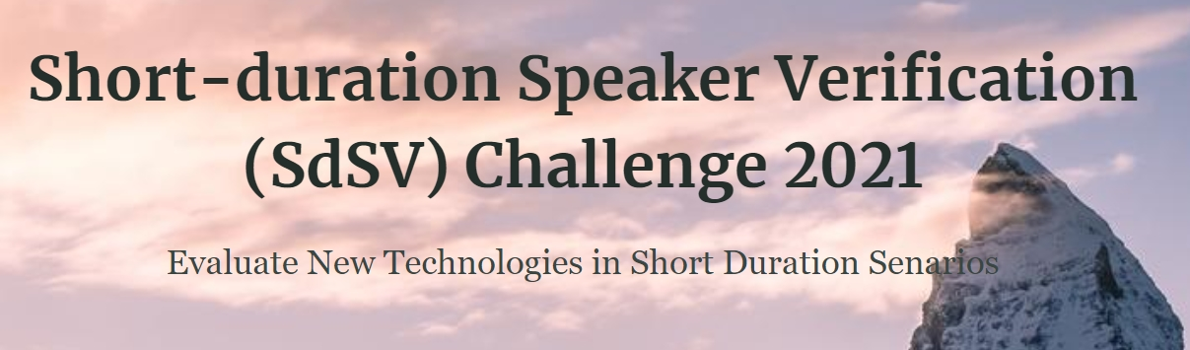
The idea of this solution is based on SdSV 2020 challenge .
Task 1 is defined as speaker verification in a text-dependent mode where the lexical content (in both English and Persian) of the test utterances is also taken into consideration.
Task 2 is defined as speaker verification in a text-independent mode with same- and cross-language trials.
Challenge Description | SdSV Challenge 2021 : sharif Deepmind

Slide 3
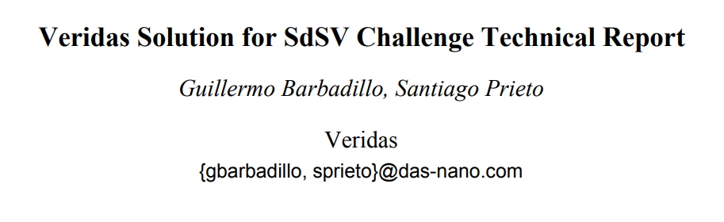
https://sdsvc.github.io/2020/descriptions/Team41_Task2.pdf

Slide 4
2. Experimental Setup
2-1 : training data:
due to lack of time only Voxceleb-2 dev set was used for training on both track 1,2
2-1 : validation data:
For Track 1 Voxceleb1 test set was used for validation .
For Track 2 Voxceleb2 test set was used for validation.
3-1 : Data Augmentation:
based on Kaldi recipe. With four categories .
● Reverberation with RIRs
● Augmentation with Musan noise
● Augmentation with Musan music
● Augmentation with Musan bable

Slide 5
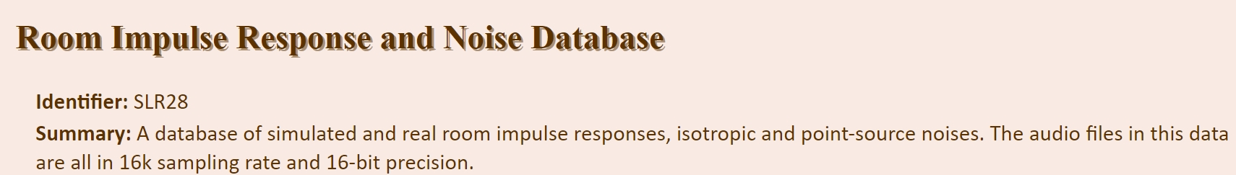
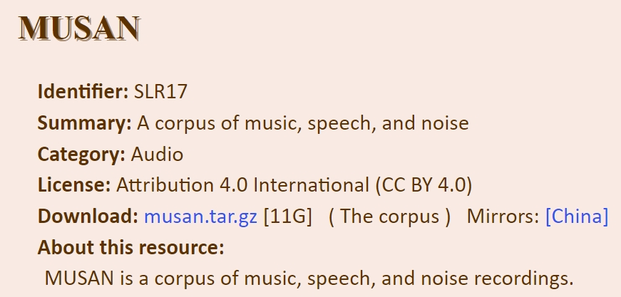
RIR : http://www.openslr.org/28
Musan : http://www.openslr.org/17

Slide 6
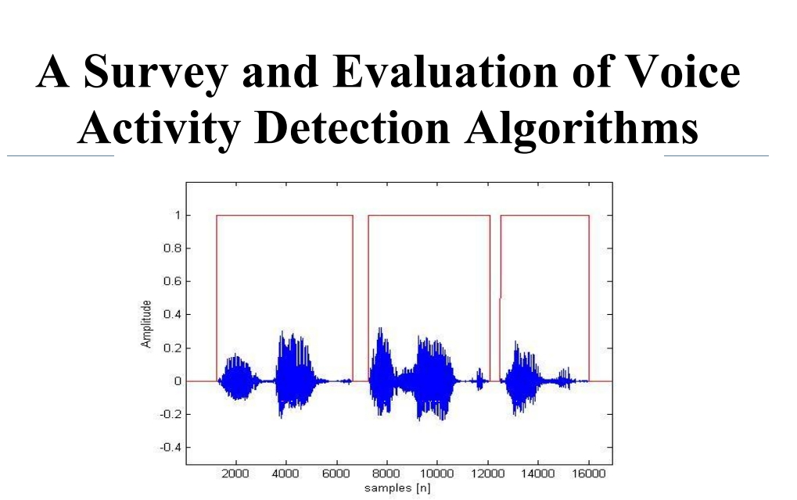
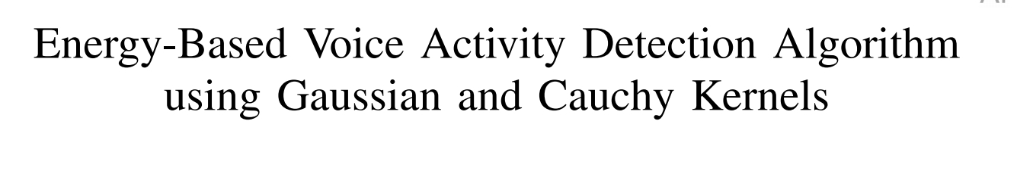
2. Experimental Setup
2.4 : input features :
All models used MFCC as input but with different number of filters to have variability
Most of models used split of 3 seconds but also 2,4 seconds were tried
The audio were cleaned using energy base VAD ( voice activity detector )
Link1
Link2

Slide 7
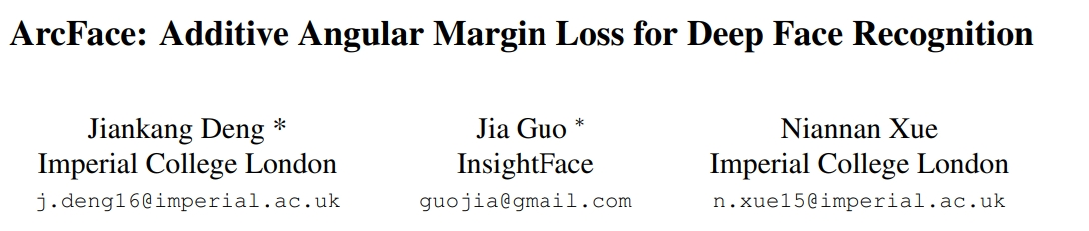
3 . models
-Models based on ResNet and ECAPA-TDNN
- m2 margin used in all models as in below article :
Link

Slide 8
4.Back-end
4.1 Euclidean distance
-embeddings of the speakers are restricted to lie on a hypersphere of radius 1
-euclidean distance is equivalent to cosine distance but faster to compute
-used euclidean distance for measuring similarity between embeddings.
-no preprocessing nor centering of the embeddings.

Slide 9
4.2 Score normalization
Used adaptative symmetric score normalization ( adapt s-norm )
with 250 top scoring speaker
4.3 Calibration and fusion
Final system is weighted avg of all the models, optimized for minimize minDCF on VoxCeleb1 or 2

Slide 10
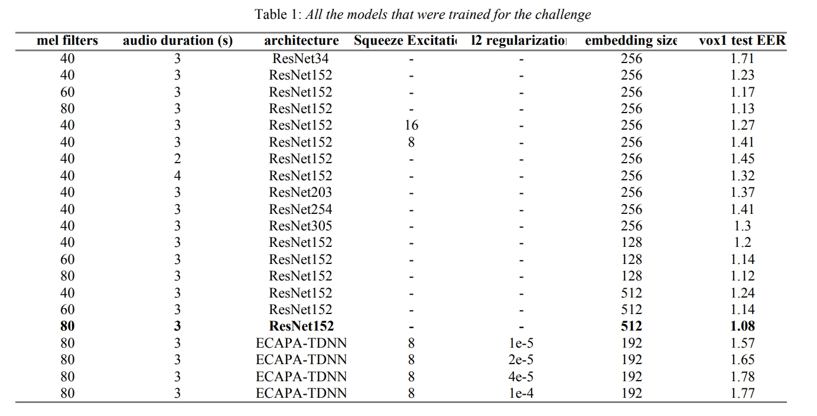
Result : EER on Voxceleb1 test set has been lowered from 1.02% to 0.7% which is an compared to 2019 winner

